Slide 1

THE ROGER-EBERT BOT
Predicting the Renowned Late Movie Critic’s Rating
Presented by: Crystal Huang
Metis Bootcamp Project II
Notes:
Hi everyone, my project is called The Roger-Ebert Bot, which I named after the renowned late movie critic.
And just a quick introduction, but I wont dive deep in his bibliography

Slide 2
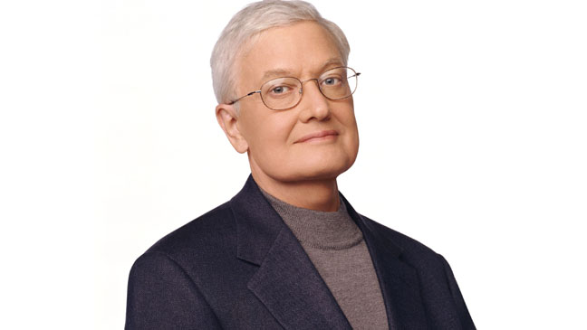

INTRODUCTION
Why is his review important?
Balanced reviews that appreciate a movie’s virtues and identify its faults
Reviewed over 7,000 movies in 24 years of his career
Who’d find his reviews useful?
Movie lovers, movie critics community, directors, entertainment industry
Who is Roger Ebert?
Legendary film critic
Passed away in 2013 after battling with cancer for years
Fun fact: the only film critic with a star on Hollywood Boulevard Walk of Fame
CAN WE PREDICT HOW ROGER EBERT
WOULD RATE MOVIES
IF HE WERE ALIVE TODAY?
Notes:
if you haven't heard of him, Roger Ebert is a legendary film critic, who unfortunately passed away in 2013
Fun fact, he is the only film critic with a star on Hollywood Boulevard Walk of Fame
His importance is marked by his critical style –balanced reviews that appreciate a movie’s virtues and identify its faults
And he has reviewed over 7 thousand movies in his career
THE goal of my project is to see if we can predict how Roger Ebert would rate movies if he were alive today

Slide 3









TOOLS
Language
Web-scraping
Data manipulation
Plot graphs
Modeling & Testing
Notes:
For the project, I used beautifulsoup and selenium for web-scraping, pandas and numpy for data manipulation, matplotlib and seaborn for graphs, and scikit learn and stats models for modeling and testing

Slide 4
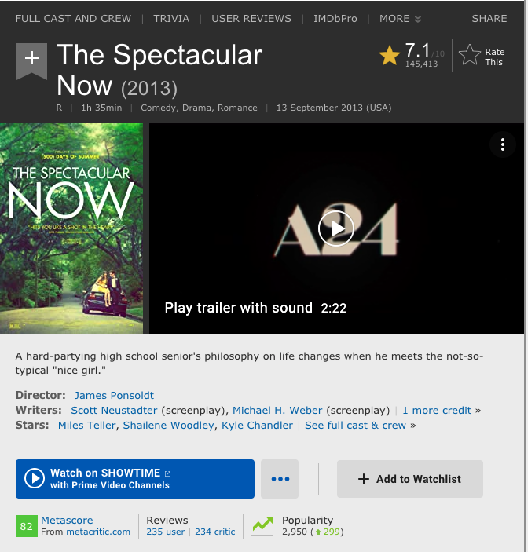
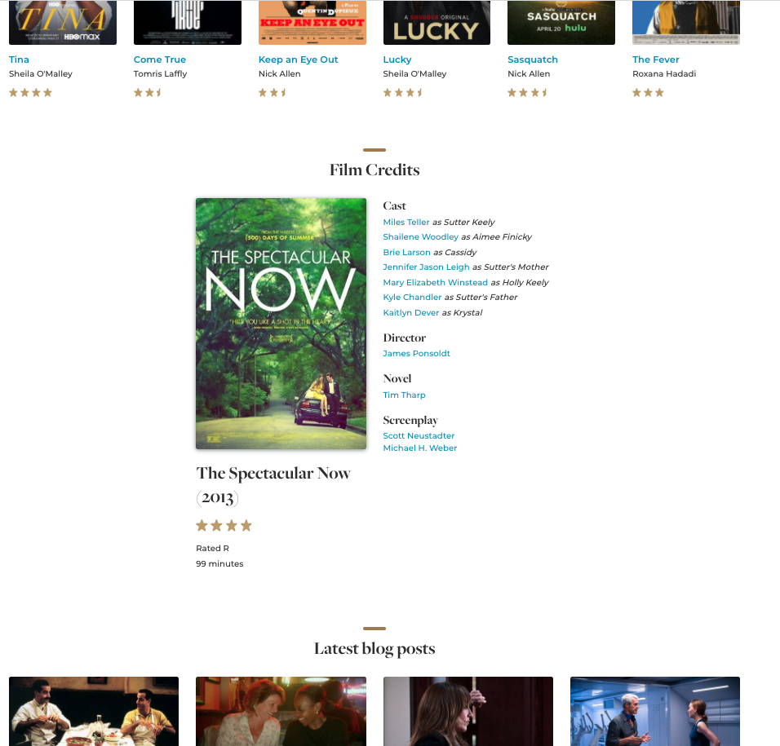
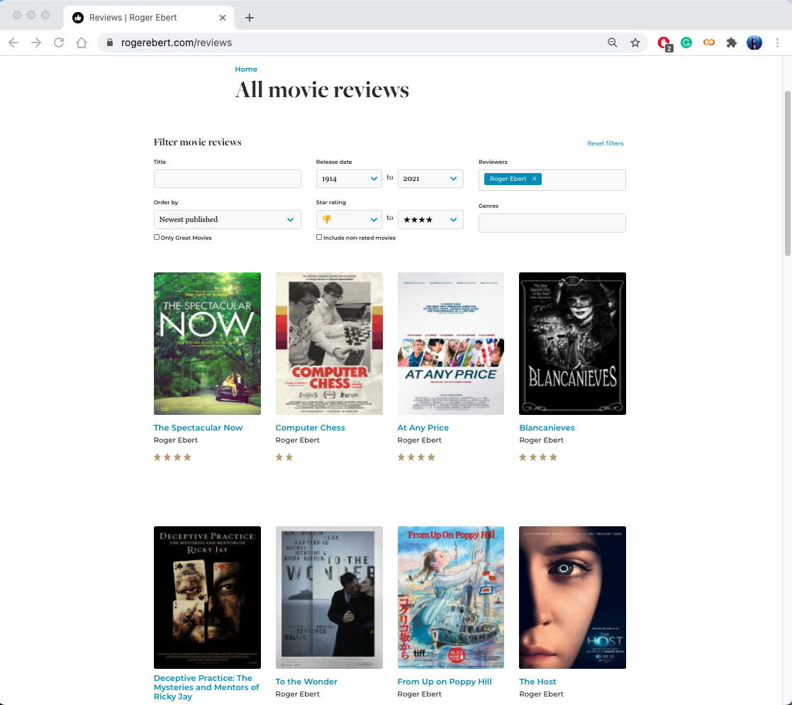
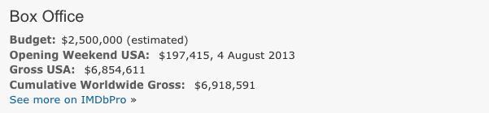
METHODOLOGY
Data Acquisition
& Cleaning
EDA,
Feature Engineering
& Selection
Train & Evaluate Model
(Model Selection)
PRIMARY:
Roger Ebert Reviews Website: https://www.rogerebert.com/reviews
SECONDARY:
MovieLens movie dataset
from Kaggle (IMDb ID)
IMDb.com
– scrap more features
Original data: 7847 datapoints
6 features
Final data: 2191 datapoints,
11 features
Notes:
I scraped my primary dataset from the critic’s own website, BUT the website's movie details is not consistent nor sufficient for the features
I wanted more data SO I found a movielens dataset to get the imdb id of the movies
USED that to do a second data scraping from imdb website for more features
ORIGINALLY, I have close to 8 thousand datapoints and 6 features.
After merging and cleaning, I have about 2 thousand datapoints and almost double the features

Slide 5
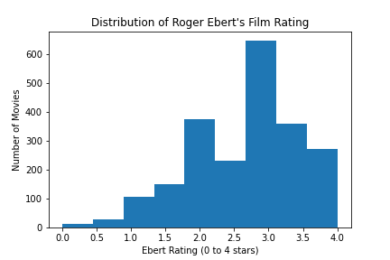
METHODOLOGY
Data Acquisition
& Cleaning
EDA,
Feature Engineering
& Selection
Train & Evaluate Model
(Model Selection)
TARGET:
Ebert Rating
Least Amount of Ratings
Most Amount of Ratings
Notes:
My target is Ebert rating which goes from 0 to 4 and just a quick look at the distribution, HE gave almost half the movies a 3 to 3.5 rating AND he doesn’t give too many terrible movie ratings like 0 to 0.5, which may affect the model prediction in lower ratings.

Slide 6
METHODOLOGY
Data Acquisition
& Cleaning
EDA,
Feature Engineering
& Selection
Train & Evaluate Model
(Model Selection)
TARGET:
Ebert Rating
Year
MPAA Rating
Runtime
Genre
Sub-genre
MovieLens Rating
IMDb Rating
Budget
Worldwide Gross
Domestic Gross
Opening Week Gross
Notes:
and looking at the 11 features, THERE are 3 categorical features

Slide 7
METHODOLOGY
Data Acquisition
& Cleaning
EDA,
Feature Engineering
& Selection
Train & Evaluate Model
(Model Selection)
TARGET:
Ebert Rating
Year
MPAA Rating
Runtime
MPAA Rating
Genre
Sub-genre
Genre
Sub-genre
MovieLens Rating
IMDb Rating
Budget
Budget
Budget
Worldwide Gross
Domestic Gross
Opening Week Gross
Worldwide Gross
Opening Week Gross
Worldwide Gross
Domestic Gross
Opening Week Gross
Domestic Gross
Genre
dummies
Sub-genre
dummies
MPAA Rating
dummies
Opening Gross Proportion
Notes:
which I MADE dummy variables from. And SINCE these pink highlighted numerical features have high collinearity, I FEATURE engineered a combined feature and DISCARD those in grey.

Slide 8
METHODOLOGY
Data Acquisition
& Cleaning
EDA,
Feature Engineering
& Selection
Train & Evaluate Model
(Model Selection)
TARGET:
Ebert Rating
Year
MPAA Rating
Runtime
Genre
Sub-genre
MovieLens Rating
IMDb Rating
65 Features
Budget
Worldwide Gross
Domestic Gross
Opening Week Gross
Genre
dummies
Sub-genre
dummies
MPAA Rating
dummies
Opening Gross Proportion
Notes:
NOW i have about 65 features
and my approach is forward step analysis, I only selected the features with higher coefficients for baseline modeling and then build from there.

Slide 9
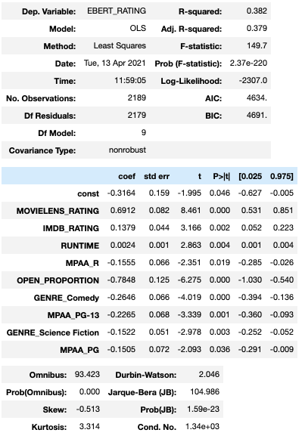
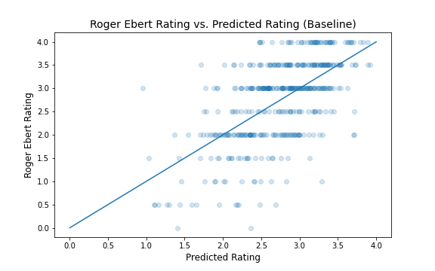


METHODOLOGY
Data Acquisition
& Cleaning
EDA,
Feature Engineering
& Selection
Train & Evaluate Model
(Model Selection)
BASELINE
MODEL
9 features with
p-values <0.05
CAN I IMPROVE MY MODEL?
Notes:
My baseline HAS a R square of 0.382, USING the 9 features with p-values of less than 0.05. IN the prediction plot you can see that the model doesn’t do as well in the lower rating prediction as the higher rating. SO what can I do to improve my model?

Slide 10
METHODOLOGY
Data Acquisition
& Cleaning
EDA,
Feature Engineering
& Selection
Train & Evaluate Model
(Model Selection)
Cross Validation on Each Model (Baseline)
Model Type | R² (Validation) | RSME | MAE
Simple Linear Regression | 0.368 +- 0.010 | 0.682 | 0.561
Ridge | 0.368 +- 0.010 | 0.682 | 0.561
LASSO | 0.368 +- 0.009 | 0.684 | 0.563
Polynomial | 0.346 +- 0.017 | 0.691 | 0.570
R-squared values are close and low between models and between train and validation sets (except for Polynomial)
Suggests that the models may be underfitting
Cross Validation on Each Model (Baseline)
Model Type | R² (Validation) | R² (Train)
Simple Linear Regression | 0.368 +- 0.010 | 0.384 +- 0.002
Ridge | 0.368 +- 0.010 | 0.384 +- 0.002
LASSO | 0.368 +- 0.009 | 0.384 +- 0.002
Polynomial | 0.346 +- 0.017 | 0.408 +- 0.003
What Next?
Increase Complexity by
Adding more features to the dataset
Feature Engineering
Notes:
I first built 4 models: simple Linear, Ridge, Lasso, and polynomial., and did 5-folds cross-validation on them. But the results shows no major difference between the highlighted models. R squared are close and low between models AND between train and validation set . This suggests that models may be underfitting.
SO next, I can increase complexity of the model by adding more features to the dataset and feature engineering

Slide 11
METHODOLOGY
Data Acquisition
& Cleaning
EDA,
Feature Engineering
& Selection
Train & Evaluate Model
(Model Selection)
Cross Validation Test on each model
Feature
Engineer
Modify dataset
Re-map some categorical features
Create more Dummy variables
Log transform
power transform
Notes:
I tried re-map some categorical features, create more dummy variables, did log transform and power transform on some numerical features.
and after this iterative process

Slide 12
METHODOLOGY
Data Acquisition
& Cleaning
EDA,
Feature Engineering
& Selection
Train & Evaluate Model
(Model Selection)
Cross Validation Test on Each Model (Final)
Model Type | R² | RSME | MAE
Simple Linear Regression | 0.3708 | 0.707 | 0.560
Ridge | 0.3703 | 0.708 | 0.560
LASSO | 0.3711 | 0.707 | 0.559
Polynomial | -4077.74 | 56.97 | 9.703
Polynomial-Ridge | 0.2611 | 0.767 | 0.604
Polynomial-LASSO | 0.3454 | 0.722 | 0.574
Cross Validation Test on Each Model (Final)
Model Type | R² | RSME | MAE
Simple Linear Regression | 0.3708 | 0.707 | 0.560
Ridge | 0.3703 | 0.708 | 0.560
LASSO | 0.3711 | 0.707 | 0.559
Polynomial | -4077.74 | 56.97 | 9.703
Polynomial-Ridge | 0.2611 | 0.767 | 0.604
Polynomial-LASSO | 0.3454 | 0.722 | 0.574
Notes:
Finally I have winner– LASSO has a slightly higher validation score than the others... just by a bit.

Slide 13
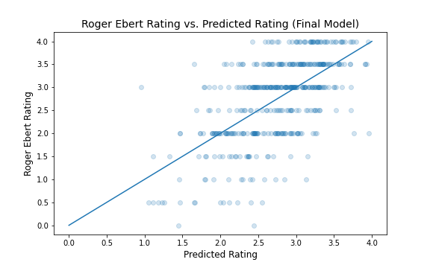
RESULTS – MODEL PERFORMANCE
 | Baseline | Final Model
R² | 0.382 | 0.396
MAE | 0.563 | 0.55
Prediction is off by about 0.5 star
Notes:
Lastly I retrained the lasso model and it returned a testing R-square that is slightly higher than the baseline.
it also has a lower mean absolute error, 0.55. IN layman’s term, the prediction is off by about 0.5 star.
THE prediction plot also show that some of the lower ratings prediction are doing slightly better.
But again, given the data doesn’t have much lower rating examples, it’s a challenge for the model to make more accurate prediction of the lower ratings

Slide 14





RESULTS – MODEL PREDICTION (VS. ACTUAL RATINGS)
3.6
2.5
1.7
4.0
2.0
1.0
Notes:
some examples on how the model did, LIFE of pi and pitch perfect are within 0.5 rating off. BUT for nightmare on elm street which is a lower rating has a weaker prediction

Slide 15






RESULTS – MODEL PREDICTION
3.6
2.6
3.4
3.5
Notes:
And just for fun, I used my model to predict Ebert’s rating on some of my recent favorite movies

Slide 16
INSIGHTS
Linear Regression may not be the best prediction model for this dataset
R-squared values are typically lower than 50% for predicting human behavior. Humans are simply harder to predict than, say, physical processes. _{[1]}
Notes:
Overall, I feel my prediction model is not the best.
But some insights from the project is that linear regression may not be the best prediction model for this dataset
and R-squared values are typically lower than 50% for predicting human behavior since human are simply harder to predict than physical processes
So my cover photo may be a bit too ambitious

Slide 17
FUTURE WORK
Non-linear prediction model
Tree-based model
More datapoints –
filling missing values in original dataset
web-scraping more features (i.e. directors, writer, actors/actress)
Flask app – deploy the prediction model
Notes:
But if i had more time, I'll try using non-linear prediction model
second is to get more datapoints by filling missing values in original dataset as well as web-scrapping more features
lastly, to built a flask app to deploy the prediction model

Slide 18
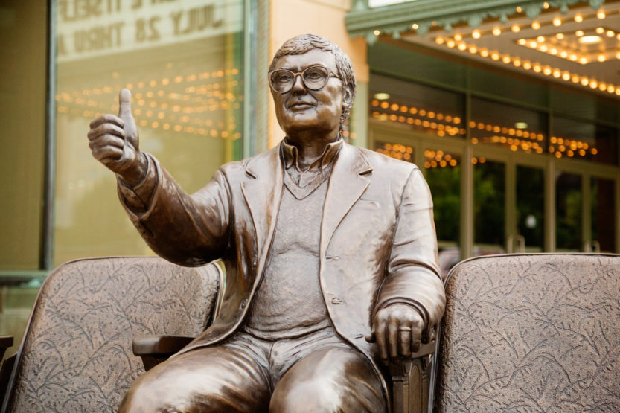


Thank you
Questions?
crystal-ctrl
crystal-huang-ds
Notes:
That’s the end of my presentation and Thank you for listening. I can take questions now

Slide 19
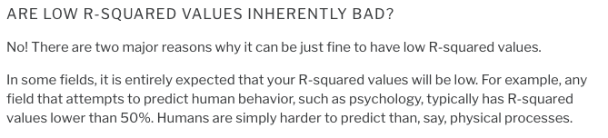
APPENDIX 1: ARTICLE CITED
How to Interpret R-squared in Regression Analysis by Jim Frost
https://statisticsbyjim.com/regression/interpret-r-squared-regression

Slide 20
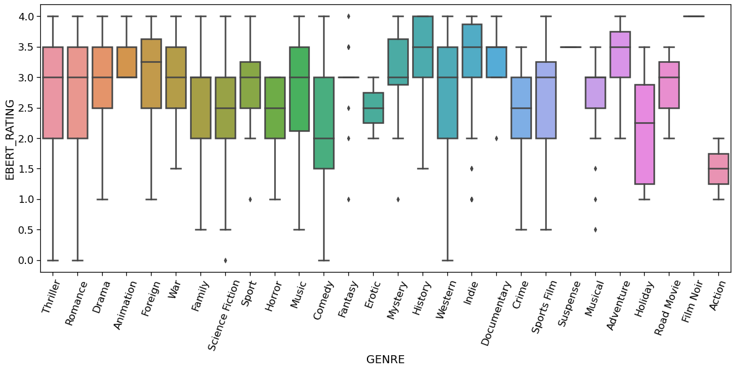
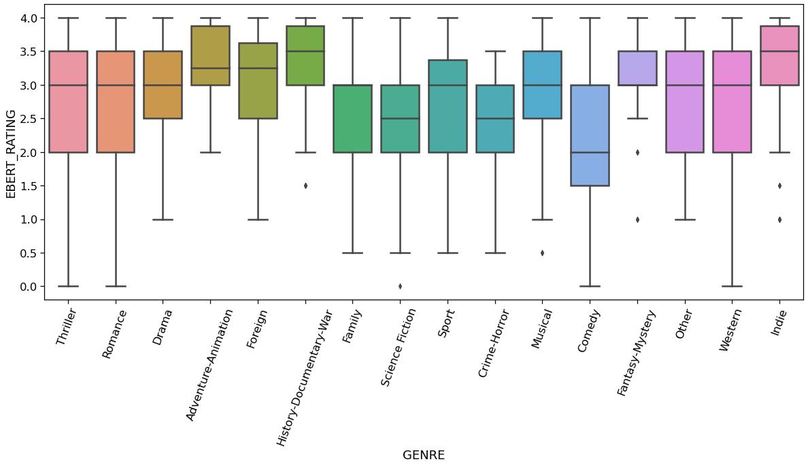
APPENDIX 2
Before
After
Notes:
i did a value counts and notice some genre only has one or single digits, so I tried to group the genre but also tried to see if their rating in the similar range
for example history-documentary-war

Slide 21
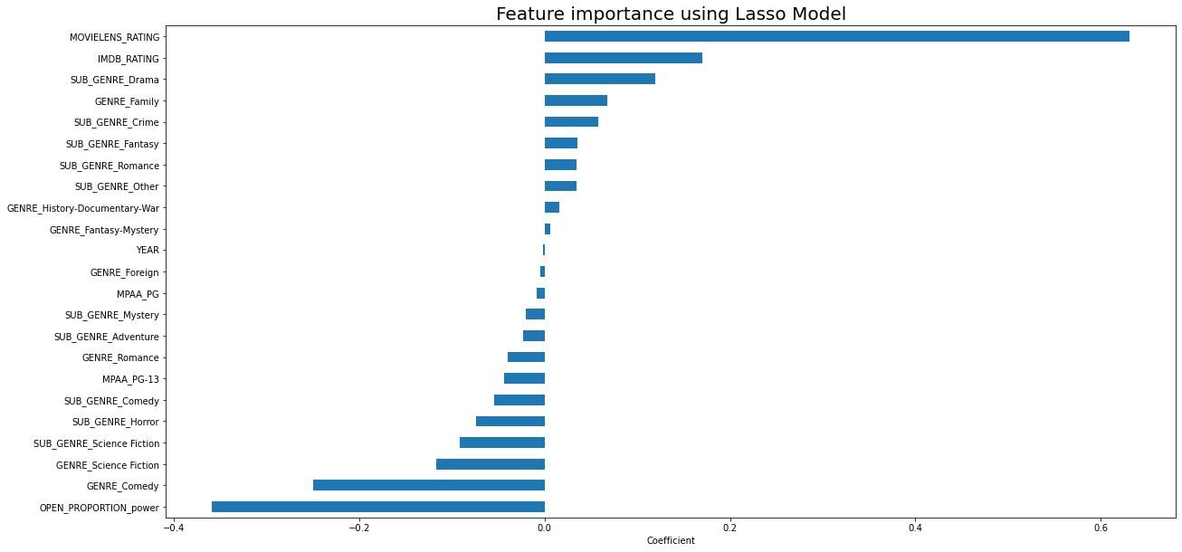
APPENDIX 3

Slide 22
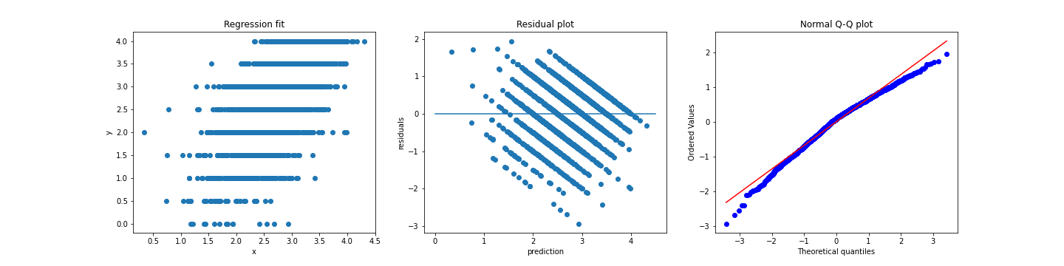
Assumption 1: Regression is linear in parameters and correctly specified
APPENDIX 4-

